Slide 1

Midwest Regional Rocket Launch Competition High Power Rocket Design Considerations

Slide 2
Design Considerations
There are a number of options you can choose between when designing a high power rocket. The decisions you make will all have an impact on your design and how well it works for your particular goals. We’ll be discussing several of the things you should try to keep in mind while working on your design.

Slide 3
Main Body Diameter
There are pros and cons to both larger and smaller body diameters. A larger body tube will produce more drag than a smaller one, but more, and larger, components can be fit into the body tube and working with the rocket can be easier, especially if you are able to fit your arm into the tube.

Slide 4
Materials
Body Tube Materials
Cardboard – cheap and easy to work with
Fiberglass – Strong, but more expensive and more difficult to work with
Carbon Fiber – Very strong, but also very expensive and equally difficult to work with

Slide 5
Materials
Fin and Center Ring Materials
Plywood – Cheap and easy to work with
Fiberglass – Stronger, but more expensive and difficult to cut and shape
Carbon Fiber – Very expensive, but also very strong and heat resistant. Difficult to work with

Slide 6
Materials
Nose Cone Materials
Plastic – Inexpensive and readily available
Fiberglass – More expensive and less readily available
Carbon Fiber – Very expensive, but great for high temperature environments, such as supersonic flight

Slide 7
Materials
Safety Concerns with Composite Materials
There are some extra issues to be aware of with fiberglass and carbon fiber. Be sure to use breathing protection, dust masks at least, when cutting or sanding composite parts, and watch out for splinters. Also keep in mind that the resulting rocket will be heavier and harder than a similar sized rocket of cardboard, wood and plastic. This means it can potentially do a lot more damage if something should go wrong and it crashes.

Slide 8
Materials
Shock Cord Materials
Nylon – Nylon webbing and tubular nylon is a popular material for shock cords
Kevlar – Kevlar, instead of nylon, is often used when a stronger, but lighter shock cord is needed. If room is tight for your recovery system you might substitute Kevlar for Nylon to save space. It is more expensive though.

Slide 9
Strength of Components
You need to build your rocket with materials and components that will be strong enough to take the loads they will experience. However, you don’t want to make them stronger, and thus heavier, than necessary. You don’t have to make everything from the strongest material available. Calculate what the maximum load will be on the rocket and then allow an adequate safety margin. Sometimes a lighter material will do just as well.

Slide 10
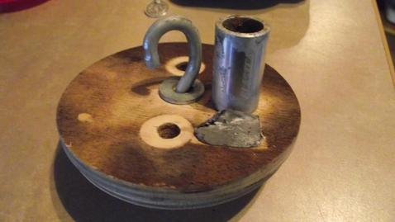
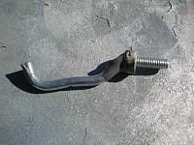
Strength of Components
Recovery System Anchor Points
Use U-Bolts or forged or welded eye-bolts for the recovery system attachment points. Regular eye-bolts can bend open under load.

Slide 11
Fin Size and Shape
You need sufficient fin surface area for stability. There should be at least 1 caliber of static stability, the distance between the CP and CG. If there is more than 2 or 3 calibers, then your rocket may be overstable and could perhaps do with smaller fins. Your simulation program should be able to give you a good idea of where the CP is and what the stability of the rocket will be. Other methods to determine stability are using a wind tunnel, a swing test and/or test flight with a scale model or computing the CP using the Barrowman equations.

Slide 12
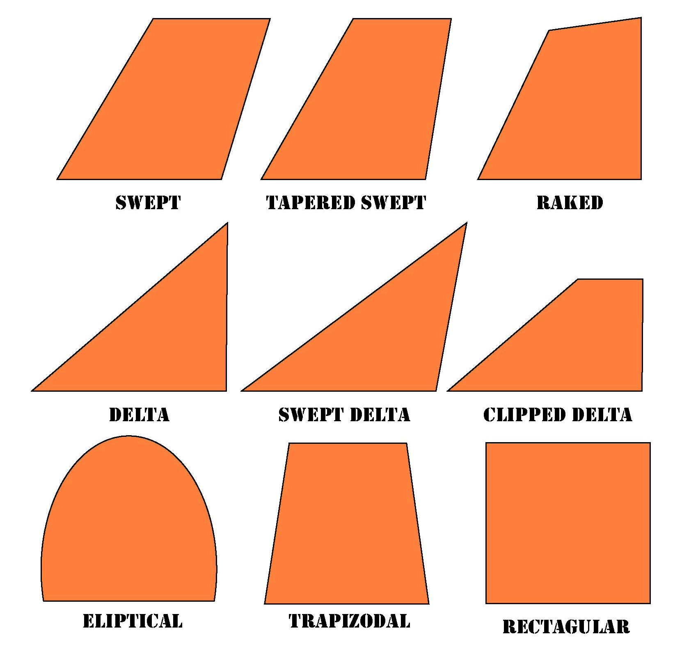
Fin Size and Shape
There are a large number of standard fin shapes.

Slide 13
Fin Size and Shape
For subsonic flight an elliptical fin is one of the best shapes. However, a trapezoidal fin is a good approximation of an elliptical fin and is much easier to make.
You might want to avoid extreme aspect ratios. You also may want to avoid forward or backward swept fins. The former are more likely to experience flutter and the later are more inclined to break on a heavy rocket when the fin tip hits first upon landing.

Slide 14
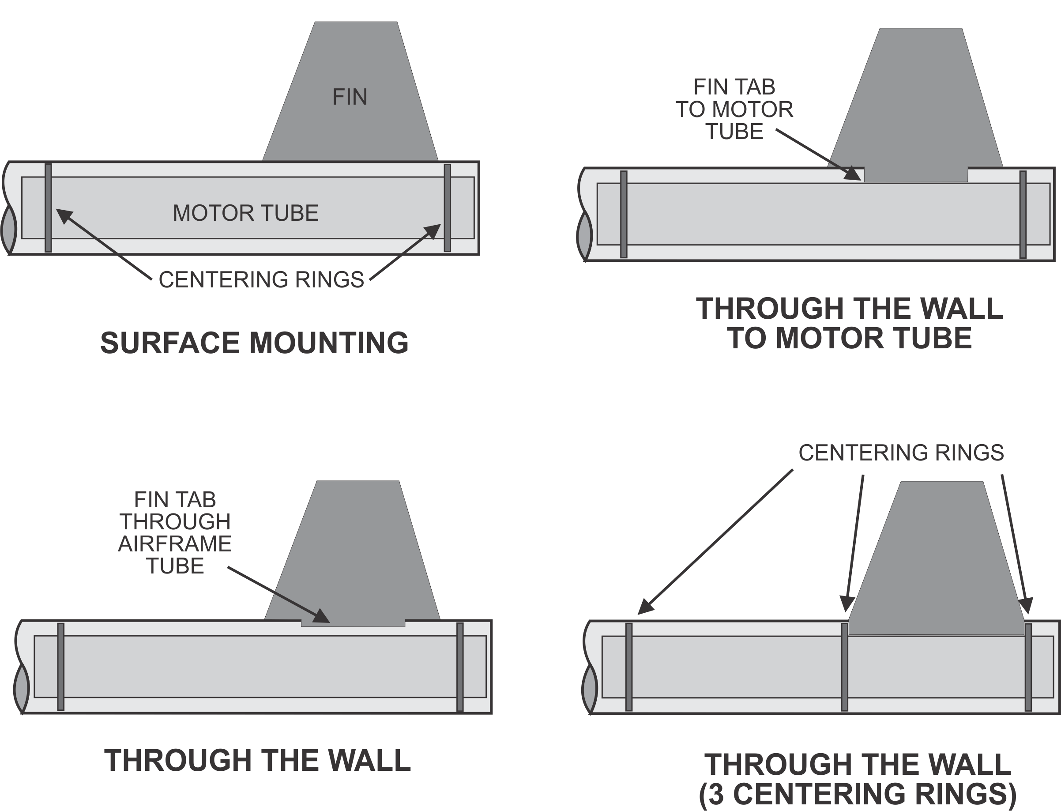
Fin Mounting Techniques
Here are some common fin mounting methods.

Slide 15
Fin Mounting Techniques
We recommend using the through-the-wall (TTW) method with 3 centering rings. This allows 6 fillets for each fin, one on each joint where the fin meets a tube. Thus there are 2 external fillets and 4 internal fillets. The way to accomplish this is to leave the aft centering ring off until the fins are mounted and the internal fillets are made. The box structures formed by the fin tabs and the middle and aft centering rings make a very strong construction.

Slide 16
Motor Retention
Motor retention is critical for a successful flight. If not properly secured the motor can be kicked out, instead of the parachute, at ejection. As you can imagine this would not be a good thing.
There are a number of commercially available motor retention systems, or you can create your own from materials available at the local hardware store.

Slide 17
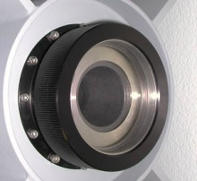
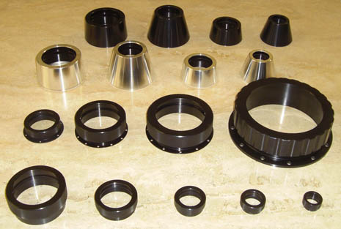
Motor Retention
Many of the commercial systems consist of a threaded part on the motor tube, with a cap that screws on to hold the motor.

Slide 18
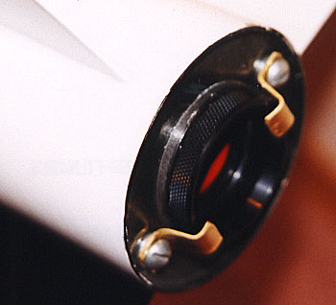
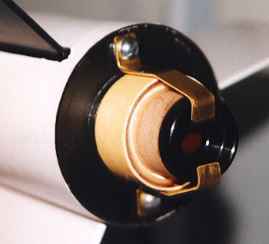
Motor Retention
One method of making your own motor retainer is to use brass stock to make clips that are attached to blind nuts in the aft centering ring.

Slide 19
Recovery System Deployment
There are three methods typically used for deploying the recovery system.
Motor Deployment
Apogee Deployment (Electronic)
Dual Deployment (Electronic)

Slide 20
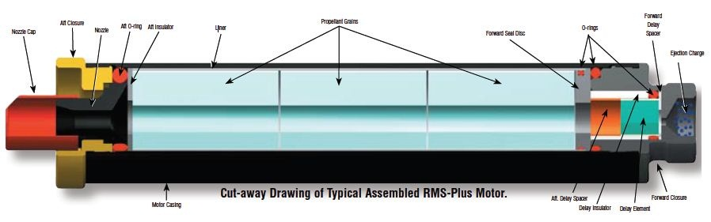
Recovery System Deployment
Motor Deployment
Most commercially manufactured rocket motors include a delay grain and ejection charge used to deploy the recovery system at apogee. The delay is selected, or set, based on predicted coast time to apogee. The delay element continues to burn after the propellant is consumed and it then lights the ejection charge which deploys the parachute.

Slide 21
Recovery System Deployment
Electronic Apogee Deployment
An altimeter or timer is used to determine when to fire the ejection charge to deploy the recovery system. Often a motor delay and ejection charge, selected to be a bit longer than the expected time to apogee, is used as a backup deployment in case of a failure with the electronic system.

Slide 22
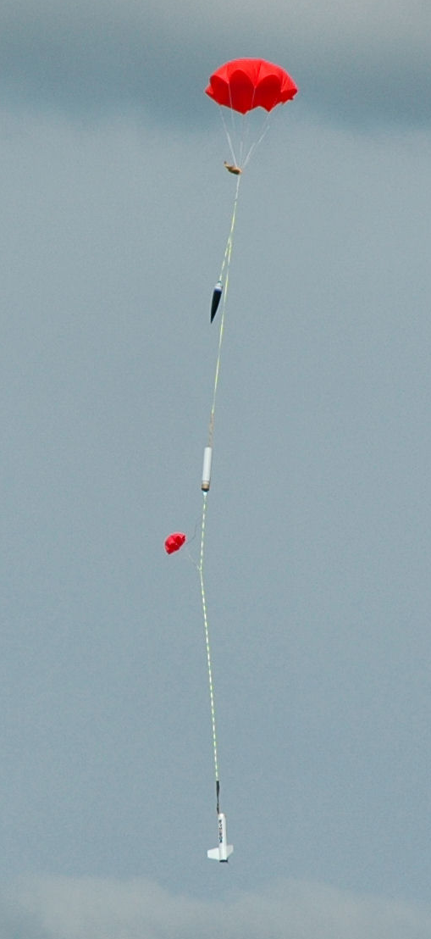
Recovery System Deployment
Electronic Dual Deployment
In this configuration the altimeter is used to deploy two parachutes, a drogue chute at apogee and the main parachute at some much lower altitude. This is done to minimize the drifting of the rocket. Since the drogue chute is very small the rocket falls very quickly, usually around 80 ft/sec until it reaches the selected altitude for main chute deployment, often around 500 feet or so. The delay and ejection charge on the motor can be used as a backup for the drogue chute deployment as well.

Slide 23
Avionics Bay
You will need a place to put the electronics. This is usually referred to as the Avionics Bay or Payload Bay. There will need to be room for the altimeter you will be using to collect data and control the recovery system deployment as well as the altimeter that will record the rocket’s altitude for the purposes of the competition.

Slide 24
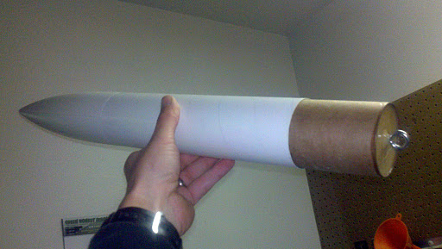
Avionics Bay
The easiest method may be to use an upper section of the body tube as a payload bay.

Slide 25
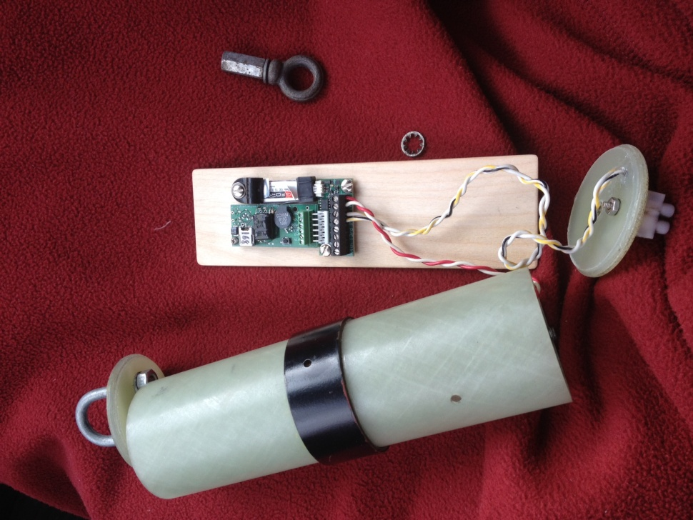
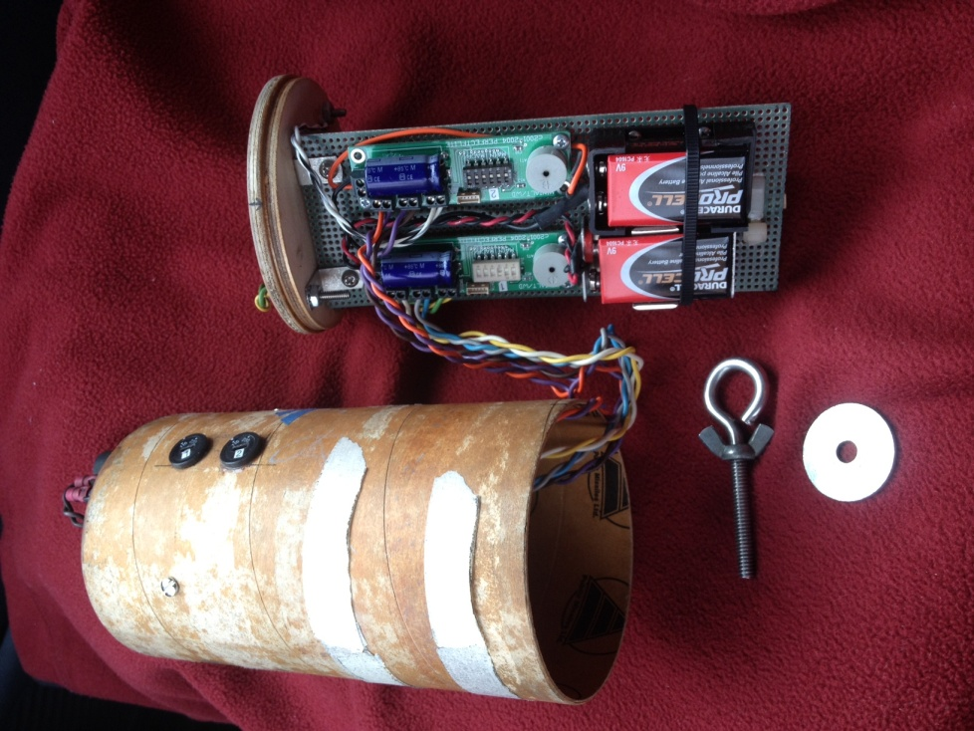
Avionics Bay
Another way is to use a coupler, closed at both ends, that goes between two sections of body tube. This is more often done in rockets using dual-deployment.

Slide 26
Avionics Bay
It is important to remember to make sure that the avionics bay holds the electronics securely and keeps them from moving and is tightly sealed off from any ejection charge gasses. If you are using a barometric altimeter the bay has to be vented to the atmosphere, but it needs to be protected from the ejection charge.

